Slide 1

GA for TSP Conventional vs Parallel
Jacob Hopkins

Slide 2
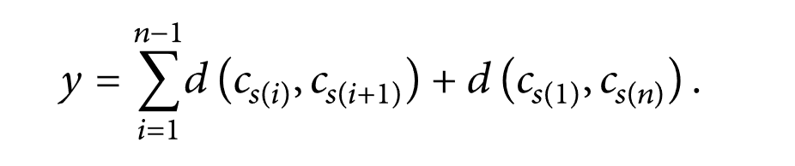
Traveling Salesperson Problem
Given a set of cities {c1,c2,c3}, the distance between every two cities is d{ ci, cj }, this problem involves seeking for the shortest sequence of cities s that makes the total distance y minimal.

Slide 3
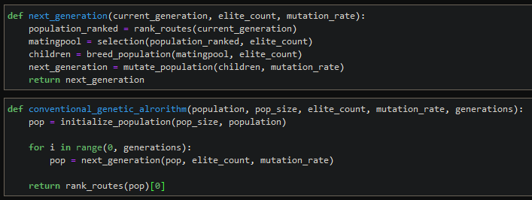
Conventional GA Design

Slide 4

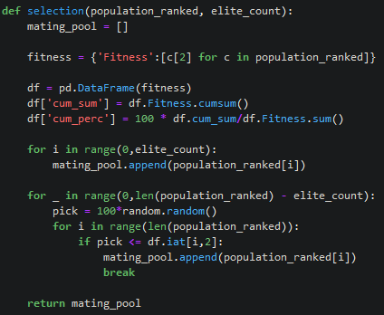
Fitness Proportionate Selection with Elitism
The fitness of individuals relative to the populations fitness’ cumulative sum is used to assign a probability of selection.
Best performing individuals from the population will automatically carry over to the next generation.

Slide 5

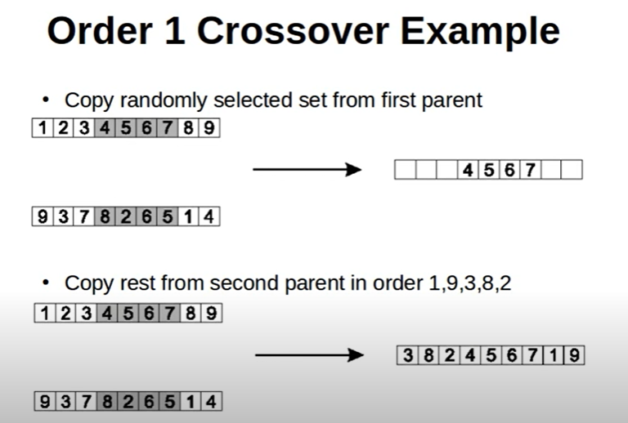
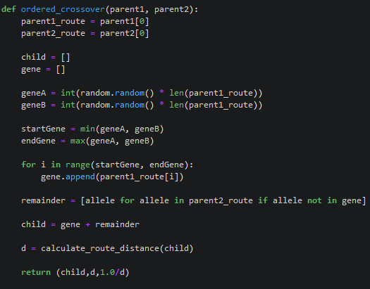
Ordered Crossover
A random sized subset of parent A is passed to the offspring.
The remaining genes in parent B are added to the offspring

Slide 6

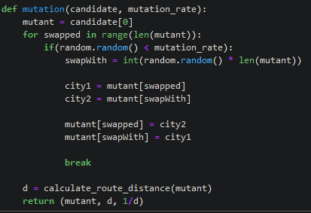
Mutation
Each gene, given some rate, has the chance to swap positions randomly
This can be applied on the elites.

Slide 7
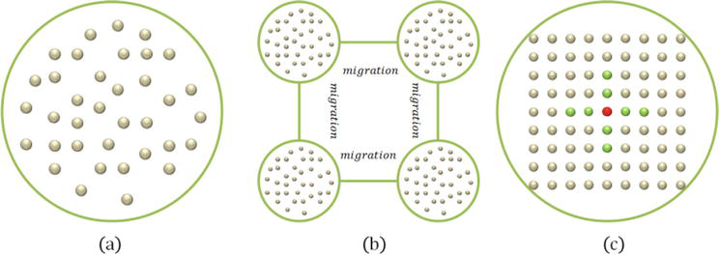
Parallel Genetic Algorithms?
Master-slave model
Single Population
Global Mating
Distributed Fitness Evaluation
Island model
Divided Population
Traditional Operators locals
Migration Operation Introduced
Cellular model
Spatially Structured
Operators Reserved to local ‘neighborhoods’
Neighborhoods overlap
Image Source: https://www.intechopen.com/books/industry-4-0-impact-on-intelligent-logistics-and-manufacturing/parallel-genetic-algorithms-with-gpu-computing

Slide 8
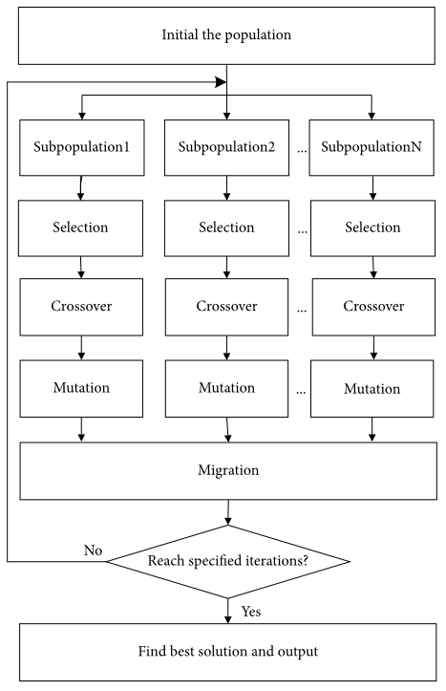
Island Model Parallel GA
Selection, mutation, and crossover operators the same, but now applied in sub populations.
Migration is applied after the completion of each subpopulation.
Using a custom CPU threading class these operations are completed simultaneously.
Image Source: https://www.hindawi.com/journals/mpe/2020/1398595/fig1/

Slide 9
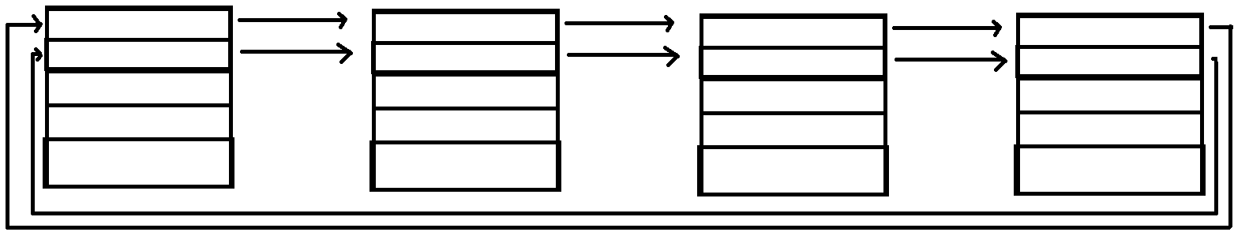
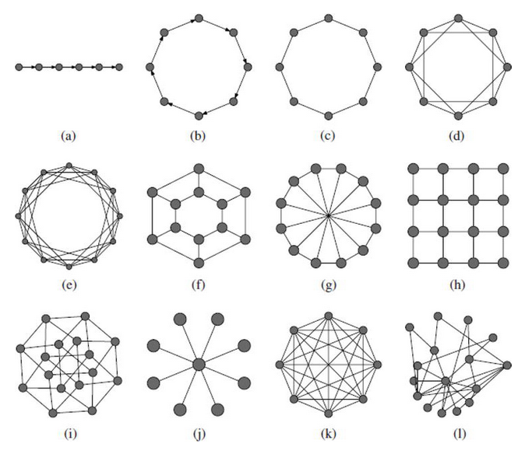
Migration
Linear Migration
Given a chance, elites from the sub populations are moved to other subpopulations.
Common migration topologies

Slide 10
MP-TESTDATA - The TSPLIB Symmetric Traveling Salesman Problem Instances
ulysses22
Odyssey of Ulysses (Groetschel and Padberg)
http://elib.zib.de/pub/mp-testdata/tsp/tsplib/tsp/ulysses22.tsp
att48
48 capitals of the US (Padberg/Rinaldi)
http://elib.zib.de/pub/mp-testdata/tsp/tsplib/tsp/att48.tsp
eil101
101-city problem (Christofides/Eilon)
http://elib.zib.de/pub/mp-testdata/tsp/tsplib/tsp/eil101.tsp

Slide 11
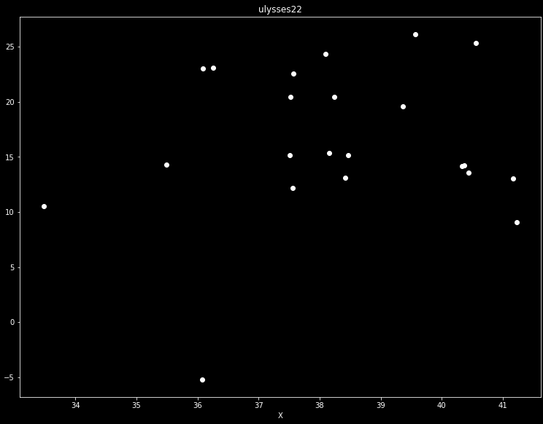
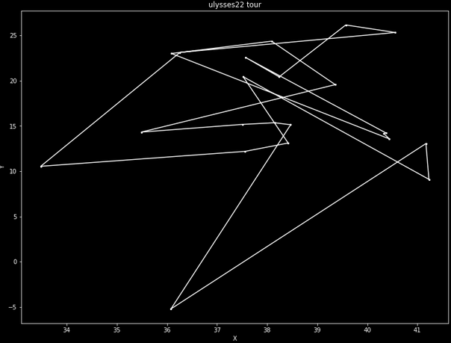
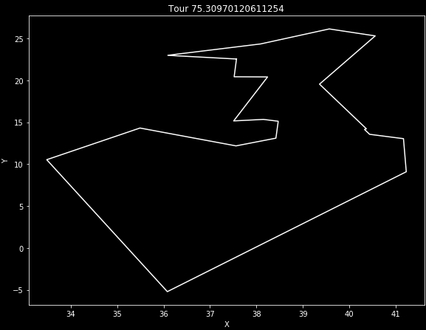
Ulysses 22 Odyssey of Ulysses (Groetschel and Padberg) http://elib.zib.de/pub/mp-testdata/tsp/tsplib/tsp/ulysses22.tsp

Slide 12
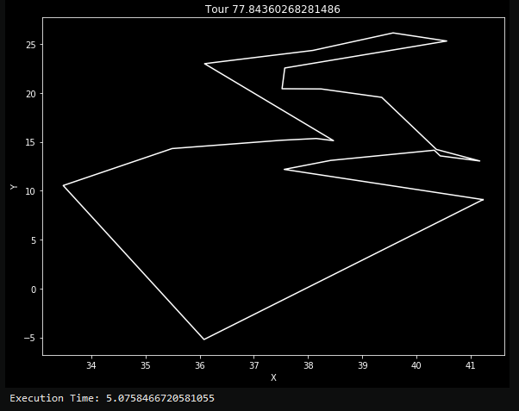
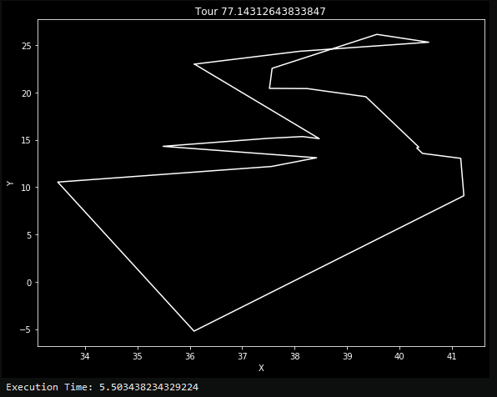
Ulysess22 Trial: Small Population
Conventional Inputs
POPULATION_SIZE = 50
ELITE_COUNT = 20
MUTATION_RATE = 0.01
GENERATIONS = 500
Parallel Inputs
POPULATION_SIZE = 50
SUB_POPULATION_COUNT = 2
ELITE_COUNT = 8
MUTATION_RATE = 0.01
migration_rate = 0.15
migration_count = 2
GENERATIONS = 500

Slide 13
Results
Conventional |  | length | average | 76.5632 | best: | 76.095 | worst: | 77.108
 |  | time | average | 5.1678 | best: | 5.129 | worst: | 5.274
Trial | length | time
1 | 76.863 | 5.274
2 | 76.43 | 5.177
3 | 76.809 | 5.14
4 | 76.43 | 5.226
5 | 76.723 | 5.138
6 | 76.491 | 5.143
7 | 76.581 | 5.173
8 | 77.108 | 5.148
9 | 76.102 | 5.129
10 | 76.095 | 5.13
Parrallel |  | length | average | 76.9369 | best: | 75.54 | worst: | 78.238
 |  | time | average | 5.588 | best: | 5.238 | worst: | 5.736
Trial | length | time
1 | 76.568 | 5.713
2 | 78.09 | 5.564
3 | 77..815 | 5.558
4 | 76.018 | 5.736
5 | 77.0651 | 5.647
6 | 78.238 | 5.646
7 | 76.662 | 5.653
8 | 77.195 | 5.603
9 | 75.54 | 5.238
10 | 77.056 | 5.522

Slide 14
Ulysess22 Trial: Medium Population
Conventional Inputs
POPULATION_SIZE = 120
Parallel Inputs
POPULATION_SIZE = 120
sub_population_count = 3
ELITE_COUNT = 15
MUTATION_RATE = 0.01
migration_rate = 0.15
migration_count = 2
GENERATIONS = 350
ELITE_COUNT = 20
MUTATION_RATE = 0.01
GENERATIONS = 350

Slide 15
Results
Conventional |  | length | average | 76.4596 | best: | 75.92 | worst: | 77.221
 |  | time | average | 15.526 | best: | 15.438 | worst: | 15.59
Trial | length | time
1 | 76.127 | 15.544
2 | 76.375 | 15.534
3 | 77.221 | 15.524
4 | 75.92 | 15.438
5 | 76.655 | 15.59
Parrallel |  | length | average | 76.9627 | best: | 75.88 | worst: | 78.074
 |  | time | average | 8.8968 | best: | 8.842 | worst: | 9.011
Trial | length | time
1 | 77.205 | 8.922
2 | 76.581 | 9.011
3 | 78.074 | 8.856
4 | 77.0735 | 8.842
5 | 75.88 | 8.853

Slide 16
Ulysess22 Trial: Large Population
Conventional Inputs
POPULATION_SIZE = 200
Parallel Inputs
POPULATION_SIZE = 200
sub_population_count = 4
ELITE_COUNT = 20
MUTATION_RATE = 0.01
migration_rate = 0.15
migration_count = 2
GENERATIONS = 250
ELITE_COUNT = 50
MUTATION_RATE = 0.01
GENERATIONS = 250

Slide 17
Results
Conventional |  | length | average | 75.8076 | best: | 75.309 | worst: | 76.431
 |  | time | average | 24.145 | best: | 23.991 | worst: | 24.309
Trial | length | time
1 | 75.88 | 23.991
2 | 76.431 | 24.145
3 | 75.309 | 24.176
4 | 76.02 | 24.104
5 | 75.398 | 24.309
Parrallel |  | length | average | 76.3884 | best: | 75.883 | worst: | 76.703
 |  | time | average | 10.5822 | best: | 10.566 | worst: | 10.591
Trial | length | time
1 | 76.703 | 10.581
2 | 76.516 | 10.588
3 | 75.883 | 10.585
4 | 76.235 | 10.591
5 | 76.605 | 10.566

Slide 18
Closing Thoughts
This algorithm can sometimes have over 50% speed increases, and seems to operate best with lower generation counts, and higher populations.

